Slide 1
Matemática
Prof. Jefferson César dos Santos

Slide 3

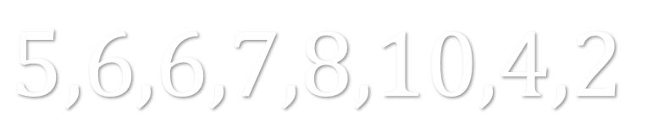
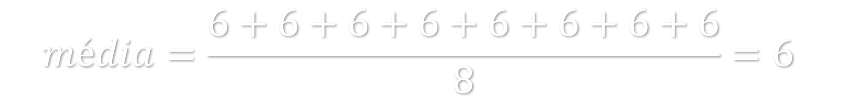
$$5,6,6,7,8,10,4,2$$
$$média=\frac{5+6+6+7+8+10+4+2}{8}=6$$
$$média=\frac{6+6+6+6+6+6+6+6}{8}=6$$

Slide 4


Calcule a média dos valores:
$7,9,8$
$$8,8,8→média=8$$
6
7
8
9
10

Slide 5
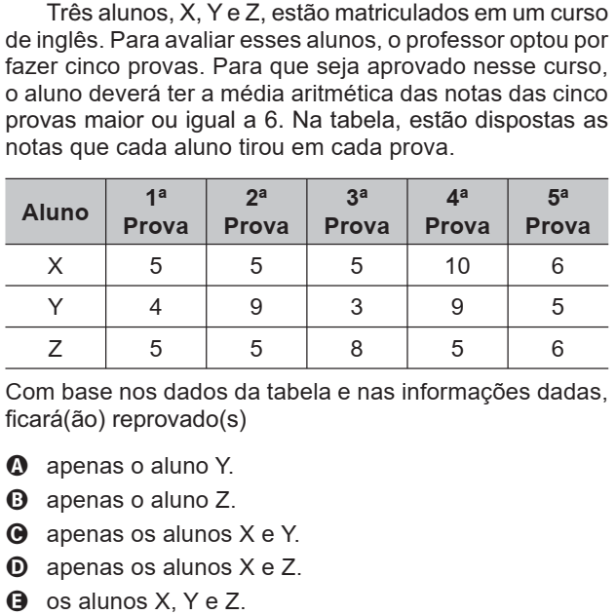
6
6
6
7
6
7
6
6
6
6
6

Slide 6
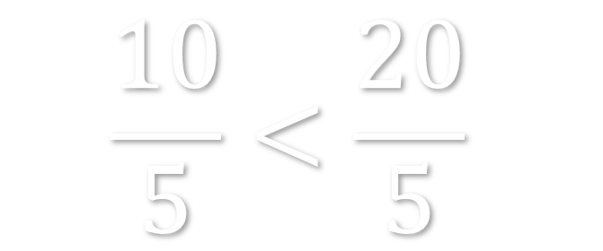

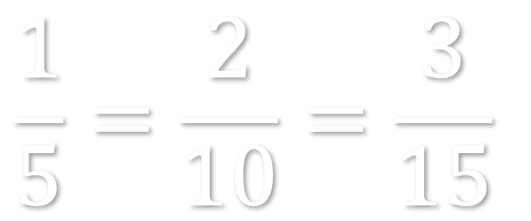
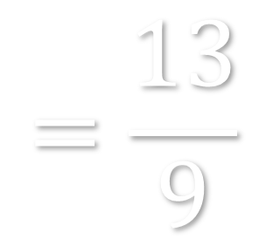

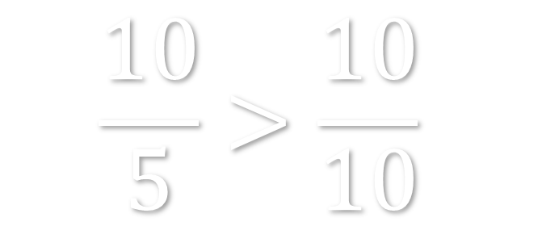
$$\frac{1}{5}=\frac{2}{10}=\frac{3}{15}$$
$$\frac{10}{5}<\frac{20}{5}$$
$$\frac{10}{5}>\frac{10}{10}$$
$$\frac{2}{3}+\frac{7}{9}$$
$$=\frac{6}{9}+\frac{7}{9}$$
$$=\frac{13}{9}$$

Slide 7
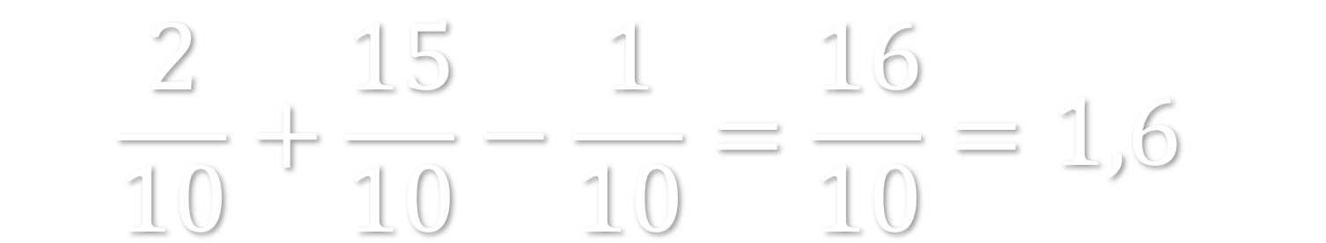
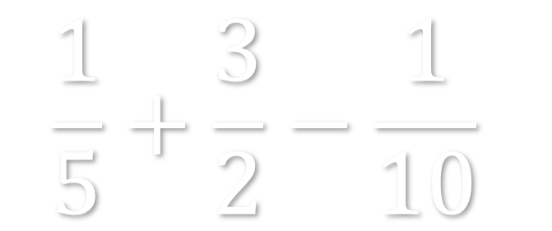
$$\frac{1}{5}+\frac{3}{2}−\frac{1}{10}$$
$$\frac{2}{10}+\frac{15}{10}−\frac{1}{10}=\frac{16}{10}=1,6$$
1
1,3
1,6
1,9
3

Slide 8
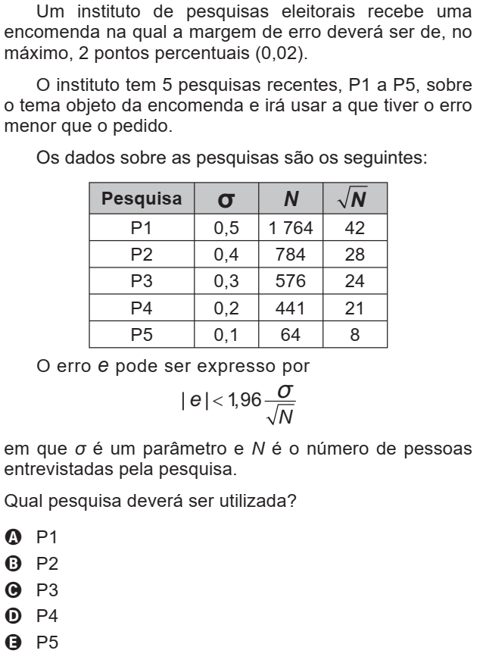
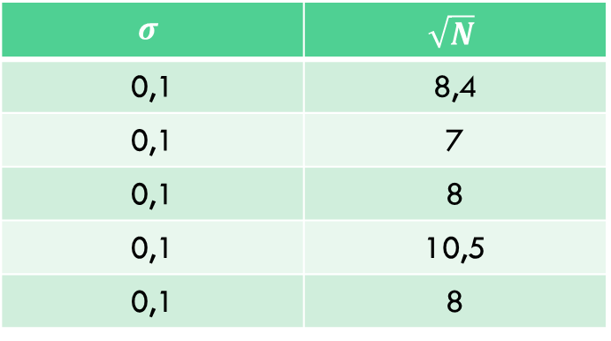
$$σ$$ | $$\sqrt{N}$$
0,1 | 8,4
0,1 | 7
0,1 | 8
0,1 | 10,5
0,1 | 8

Slide 9


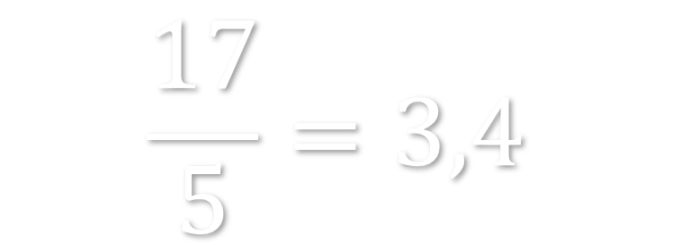
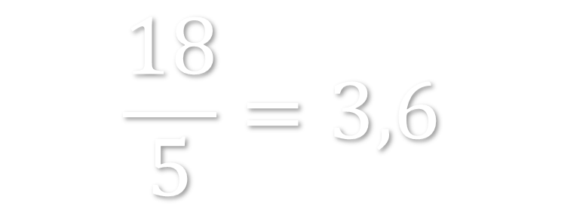
$$18∗5=90$$
$$17∗5=85$$
$$\frac{18}{5}=3,6$$
$$\frac{17}{5}=3,4$$

Slide 10


Calcule:
$248∗5$
$$248∗5=1240$$
496
4960
2480
124
1240

Slide 11
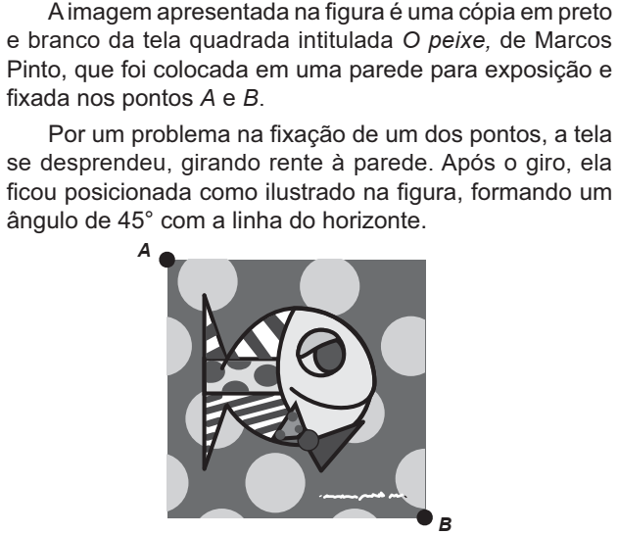
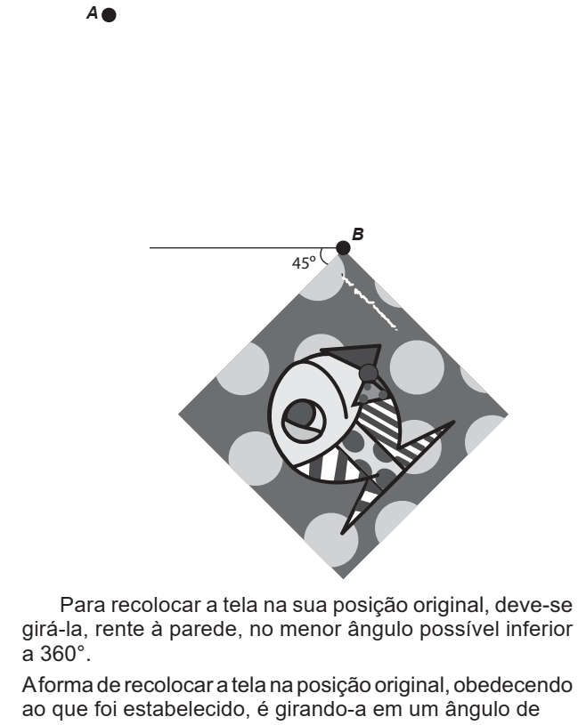
90º Sentido
Horário
135º Sentido Horário
180º Sentido Anti-Horário
270º Sentido Anti-Horário
315º Sentido Horário

Slide 12

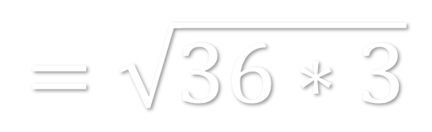
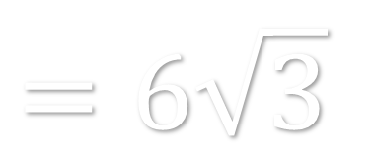

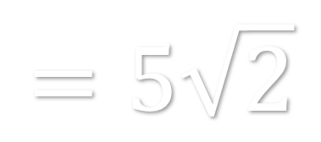
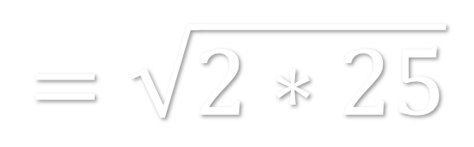
$$\sqrt{50}$$
$$=\sqrt{2∗25}$$
$$=5\sqrt{2}$$
$$\sqrt{108}$$
$$=\sqrt{36∗3}$$
$$=6\sqrt{3}$$

Slide 13
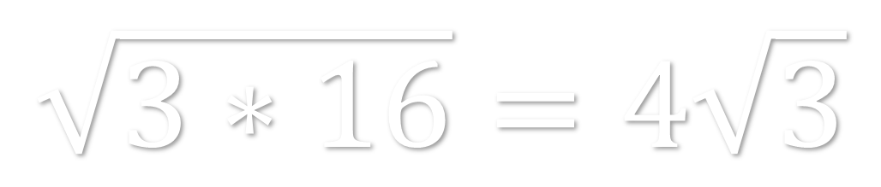
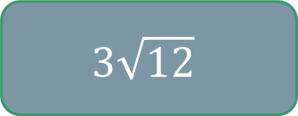
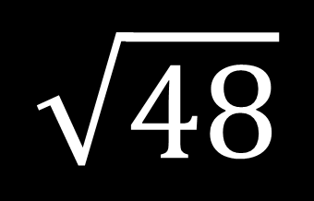



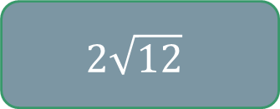
$$\sqrt{48}$$
$$\sqrt{3∗16}=4\sqrt{3}$$
$$3\sqrt{4}$$
$$4\sqrt{3}$$
$$2\sqrt{12}$$
$$3\sqrt{12}$$
$$8\sqrt{3}$$

Slide 14
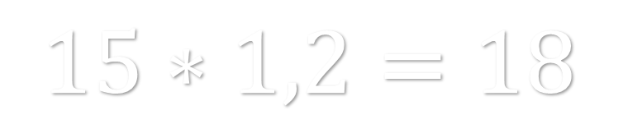
$$15∗1,2=18$$
$$(15∗1=15)+(15∗0,2=3)$$
$$15+3=18$$
$$25∗3,5=75+12,5=87,5$$

Slide 15
$$32∗2,5$$
$$32∗2,5=64+16=80$$
32
64
80
96
104

Slide 16
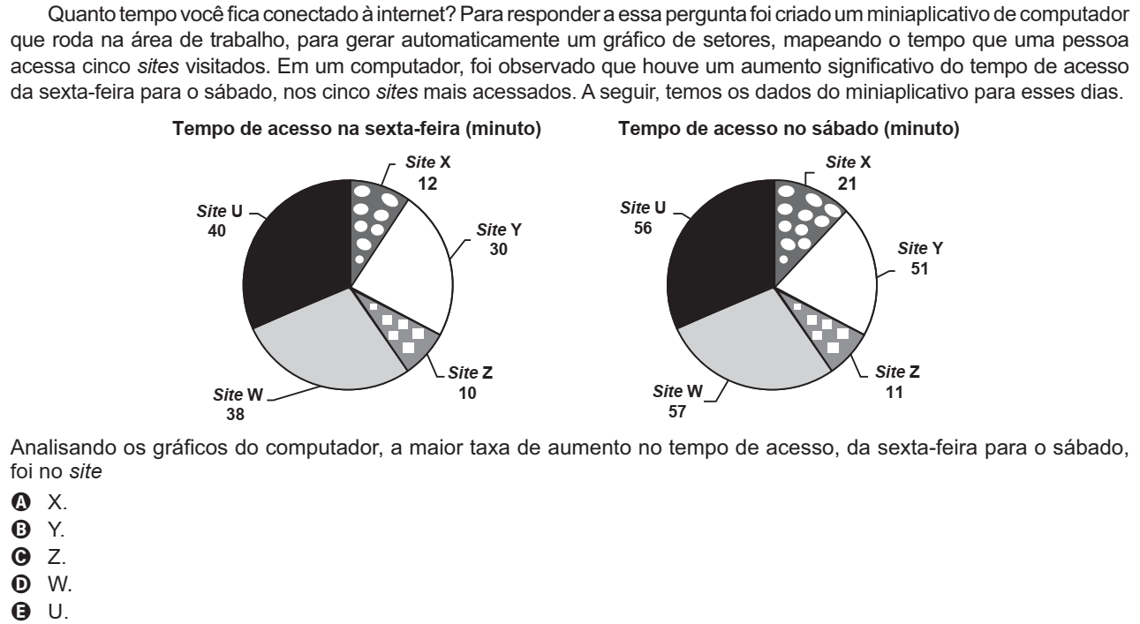
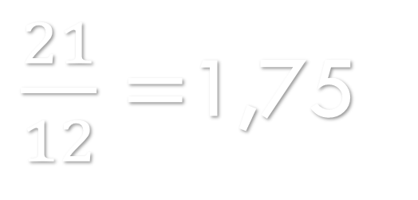


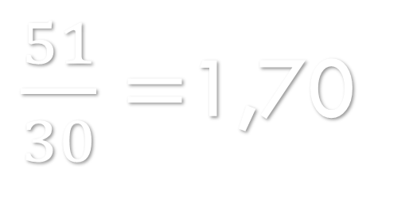
$\frac{21}{12}=$1,75
$$\frac{105}{60}$$
$\frac{51}{30}=$1,70
$$\frac{102}{60}$$
U | 40 | 56
X | 12 | 21
Y | 30 | 51
Z | 10 | 11
W | 38 | 57

Slide 17
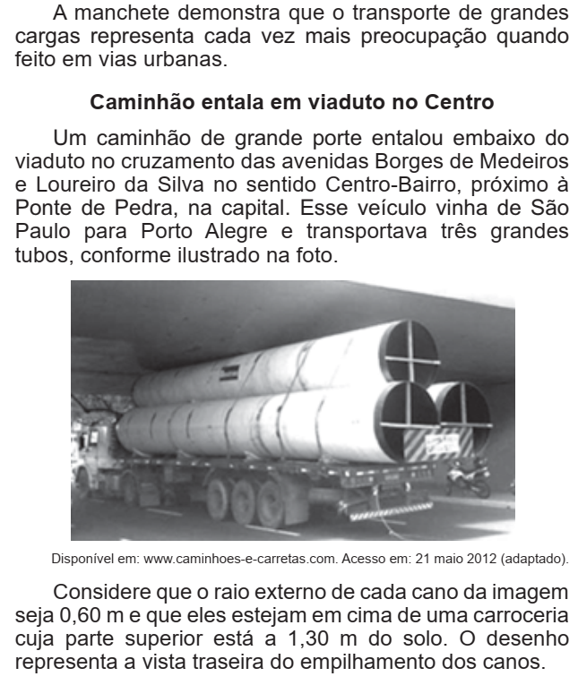
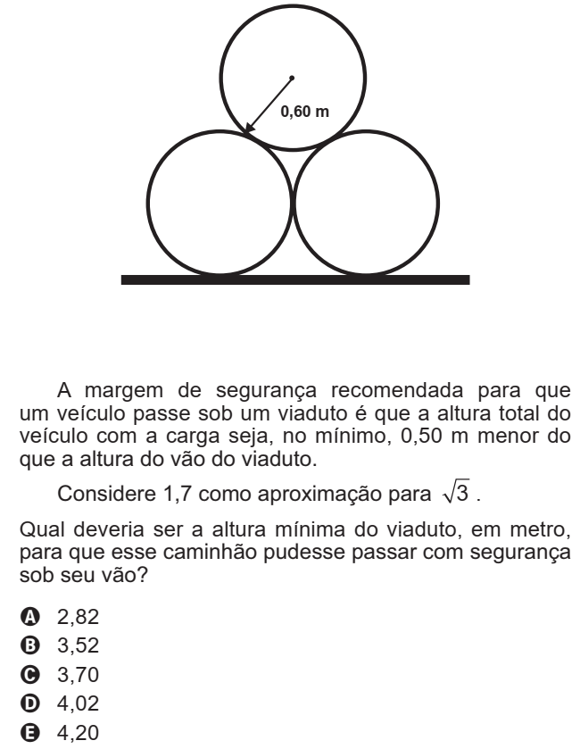



6dm
12dm
12 dm
x dm
6dm
6 dm
19dm
13dm
$$12^{2}=6^{2}+x^{2}$$
$$144−36=x^{2}$$
$$108=x^{2}$$
$$3∗36=x^{2}$$
$$\sqrt{3∗36}=x$$
$$\sqrt{3}∗6=x$$
$$x=10,2 dm$$
$$19+10,2+6+5=40,2 dm$$

Slide 18
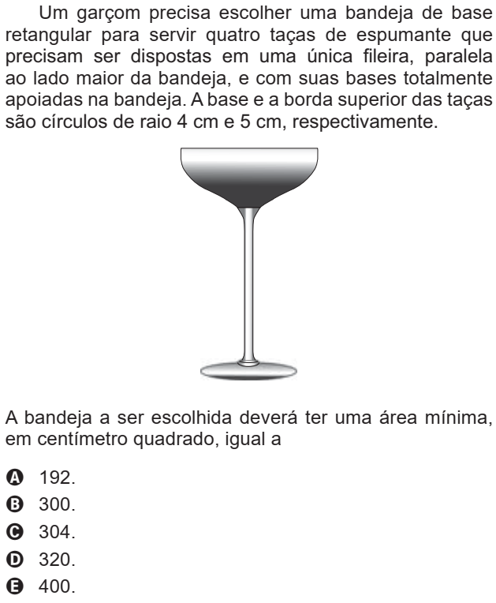
8cm
8cm
4cm
5cm
2cm
8cm
38x8=304
2cm
38cm
8cm
2cm
8cm

Slide 19

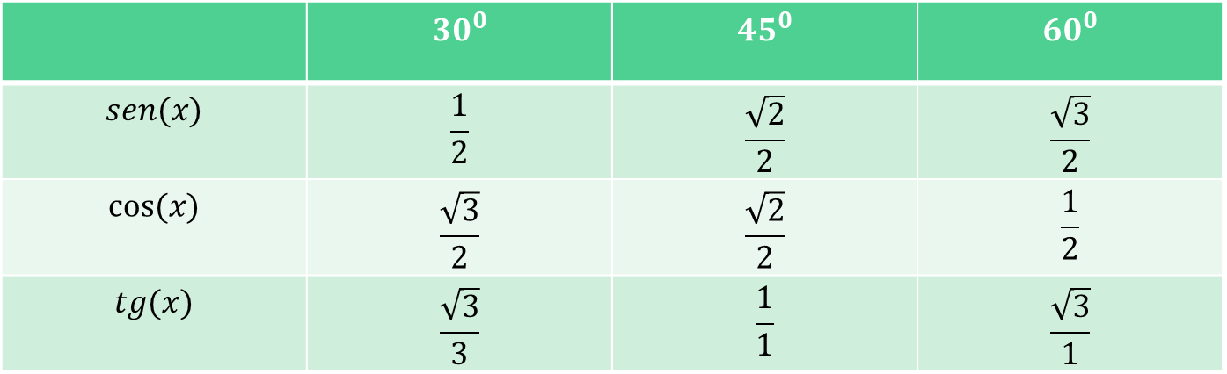
 | $$30^{0}$$ | $$45^{0}$$ | $$60^{0}$$
$$sen(x)$$ | $$\frac{1}{2}$$ | $$\frac{\sqrt{2}}{2}$$ | $$\frac{\sqrt{3}}{2}$$
$$cos⁡(x)$$ | $$\frac{\sqrt{3}}{2}$$ | $$\frac{\sqrt{2}}{2}$$ | $$\frac{1}{2}$$
$$tg(x)$$ | $$\frac{\sqrt{3}}{3}$$ | $$\frac{1}{1}$$ | $$\frac{\sqrt{3}}{1}$$
Se=co/h Co=ca/h Tg=co/ca
5
3
$$θ$$
4

Slide 20
25
x
15
10
15
20
25
30

Slide 21
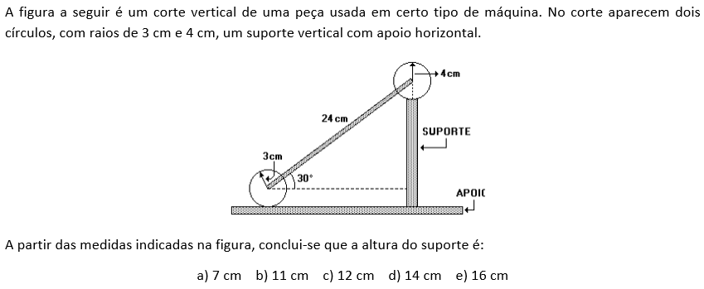
12 cm

Slide 22
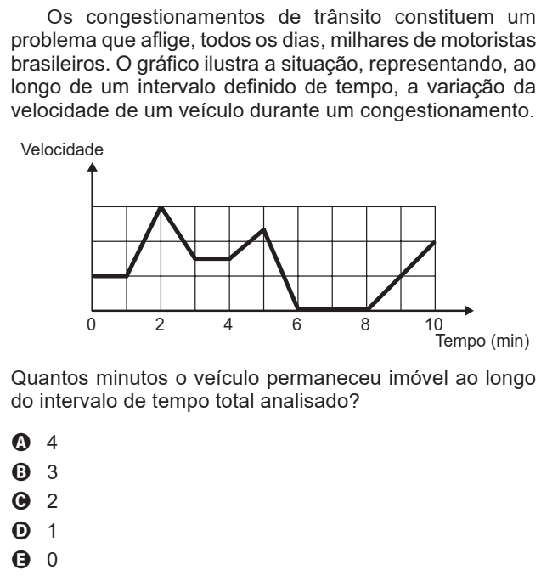

Slide 23
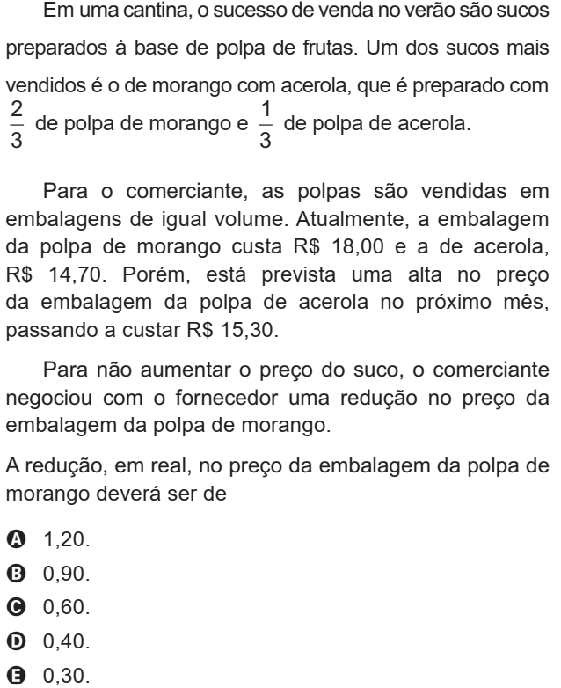

Slide 24
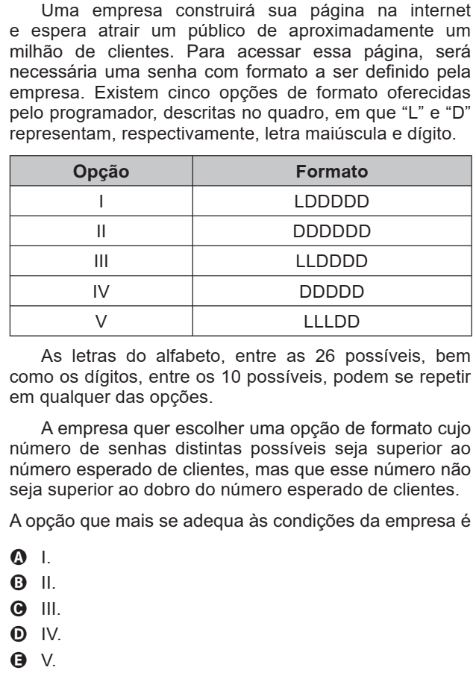
26*10*10*10*10*10=2600000
10*10*10*10*10*10=1000000
26*26*10*10*10*10=676000
10*10*10*10*10=100000
26*26*26*10*10=1757600

Slide 25
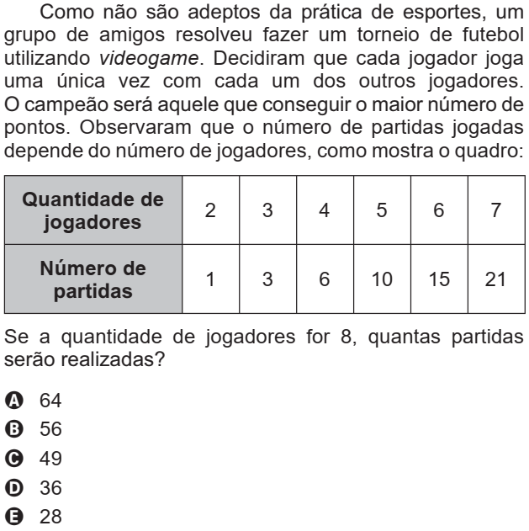
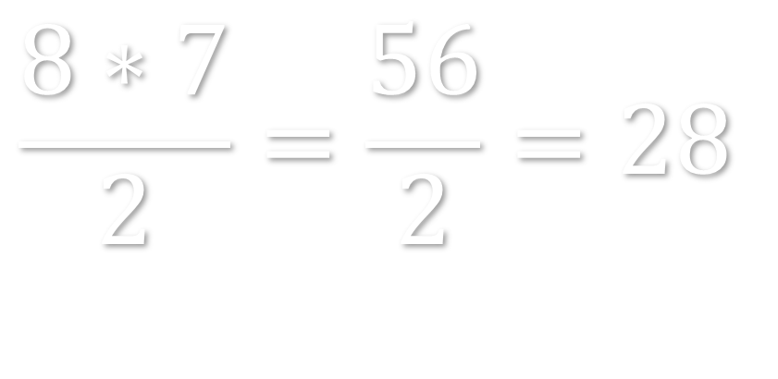
$$\frac{8∗7}{2}=\frac{56}{2}=28$$

Slide 26
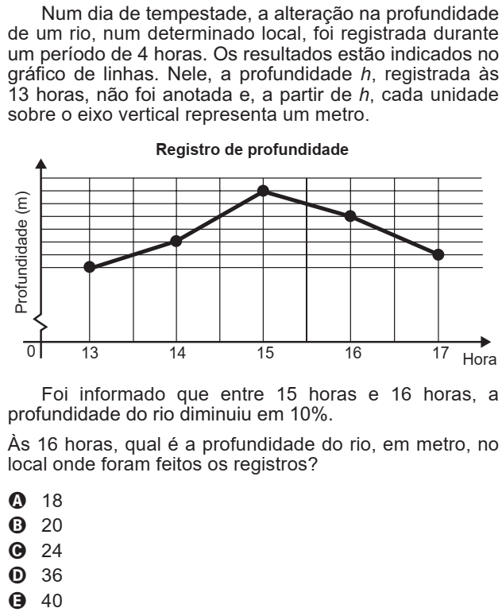
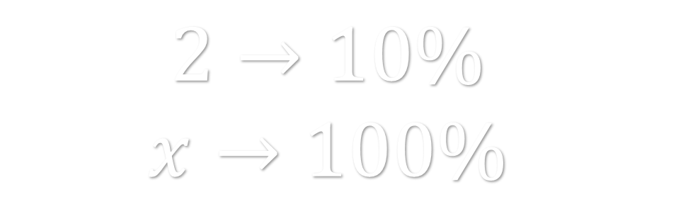

$$2→10\%$$
$$x→100\%$$
$$x=20$$

Slide 27
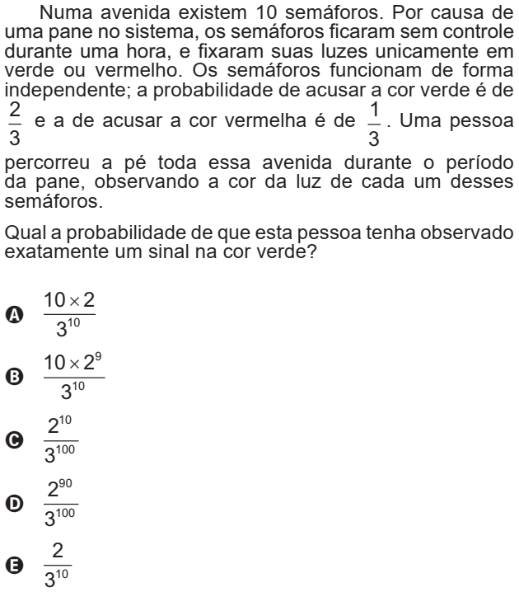
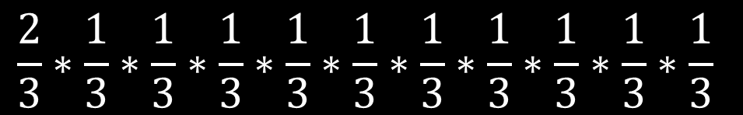

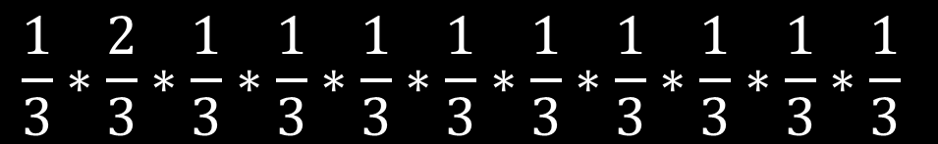
$$\frac{2}{3}∗\frac{1}{3}∗\frac{1}{3}∗\frac{1}{3}∗\frac{1}{3}∗\frac{1}{3}∗\frac{1}{3}∗\frac{1}{3}∗\frac{1}{3}∗\frac{1}{3}∗\frac{1}{3}$$
$$\frac{1}{3}∗\frac{2}{3}∗\frac{1}{3}∗\frac{1}{3}∗\frac{1}{3}∗\frac{1}{3}∗\frac{1}{3}∗\frac{1}{3}∗\frac{1}{3}∗\frac{1}{3}∗\frac{1}{3}$$
$$\frac{10∗2}{3^{10}}$$

Slide 28




$$15→20$$
$\frac{20}{15}=\frac{4}{3}=1,333→$aumentou $33,3\%$
$$20→15$$
$\frac{15}{20}=\frac{3}{4}=0,75→$diminuiu $25\%$

Slide 29
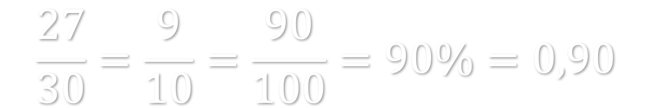
Um objeto que custava R$ 30,00, foi vendido por R$ 27,00.
$$\frac{27}{30}=\frac{9}{10}=\frac{90}{100}=90\%=0,90$$
Desconto de 10%
Desconto de 15%
Desconto de 20%
Juros de 10%
Juros de 15%

Slide 30
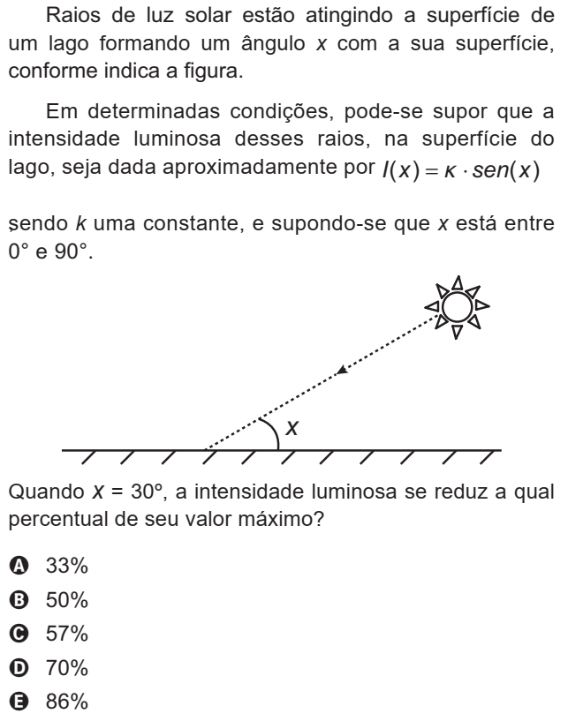
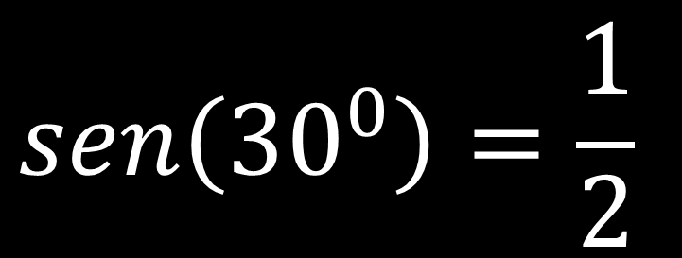
$$sen\left({30}^{0}\right)=\frac{1}{2}$$

Slide 31
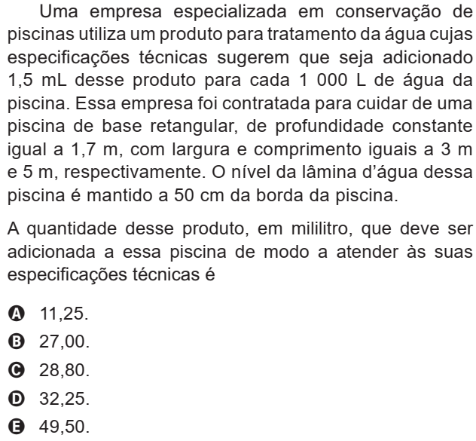
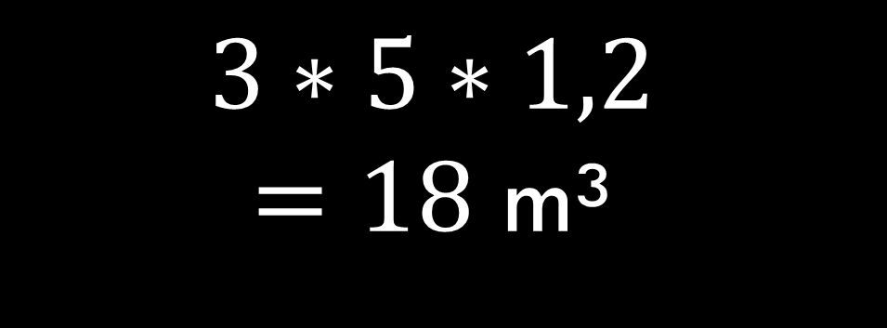

$$3∗5∗1,2$$
$=18$ m³
18000 L $→x$
1000L$→$1,5
=27 mL

Slide 32



$$\frac{3}{7}−\frac{1}{5}=\frac{15}{35}−\frac{7}{35}=\frac{8}{35}$$

Slide 33

5
4
3

